Slide 1
Chaos Systems
Experiments starting 28/09/2020

Slide 2
Making H constant
One way to guarantee H is constant is to compute dH/dt and force it to be zero.
General configuration:
simple pendulum 100 trajectories, Tmax 1.01, dt 0.01
Experiment Grid: we have 3 loss options:
Integrator/no integrator
Energy loss/no energy loss
dH/dt penalty/no dH/dt penalty
Yielding 2^3 = 8 configurations to test

Slide 3
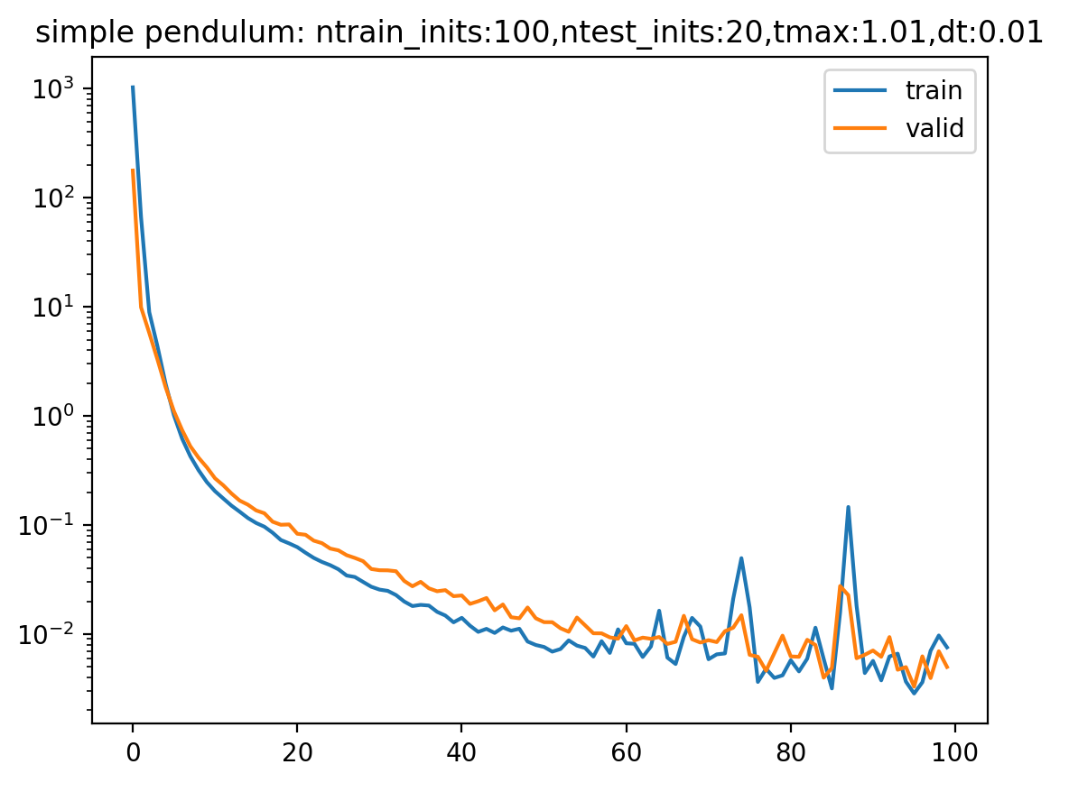
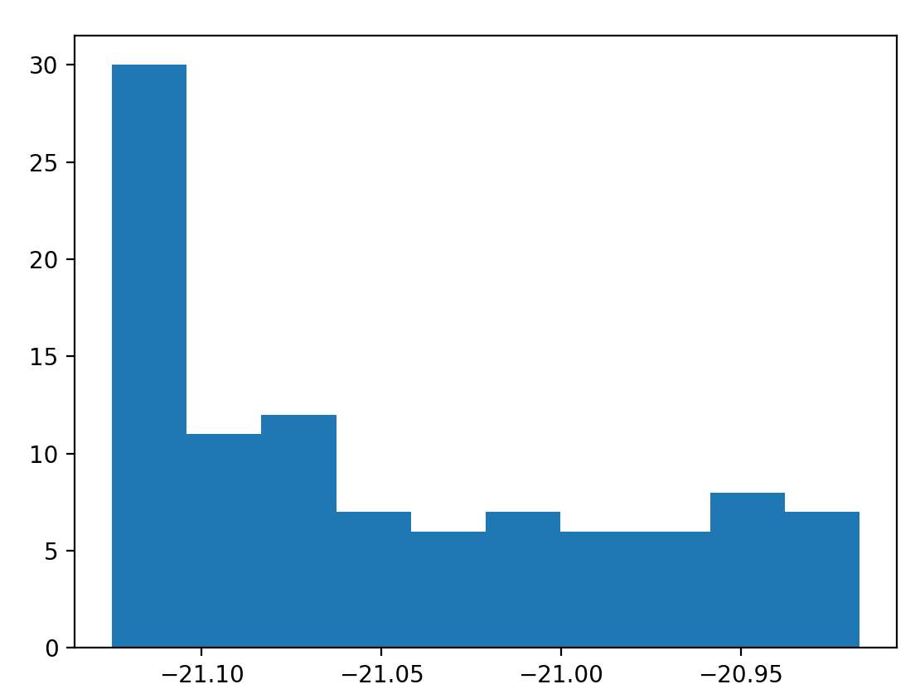
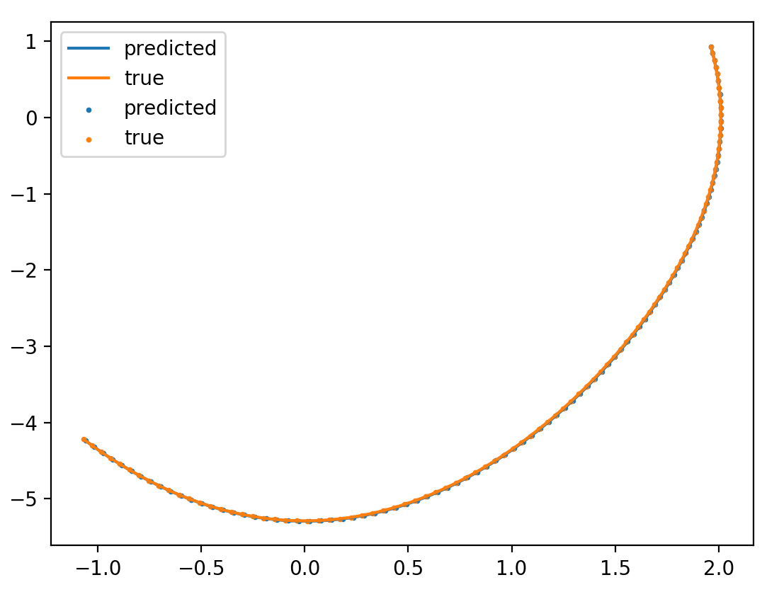
No integrator/no energy/ no dH/dt

Slide 4
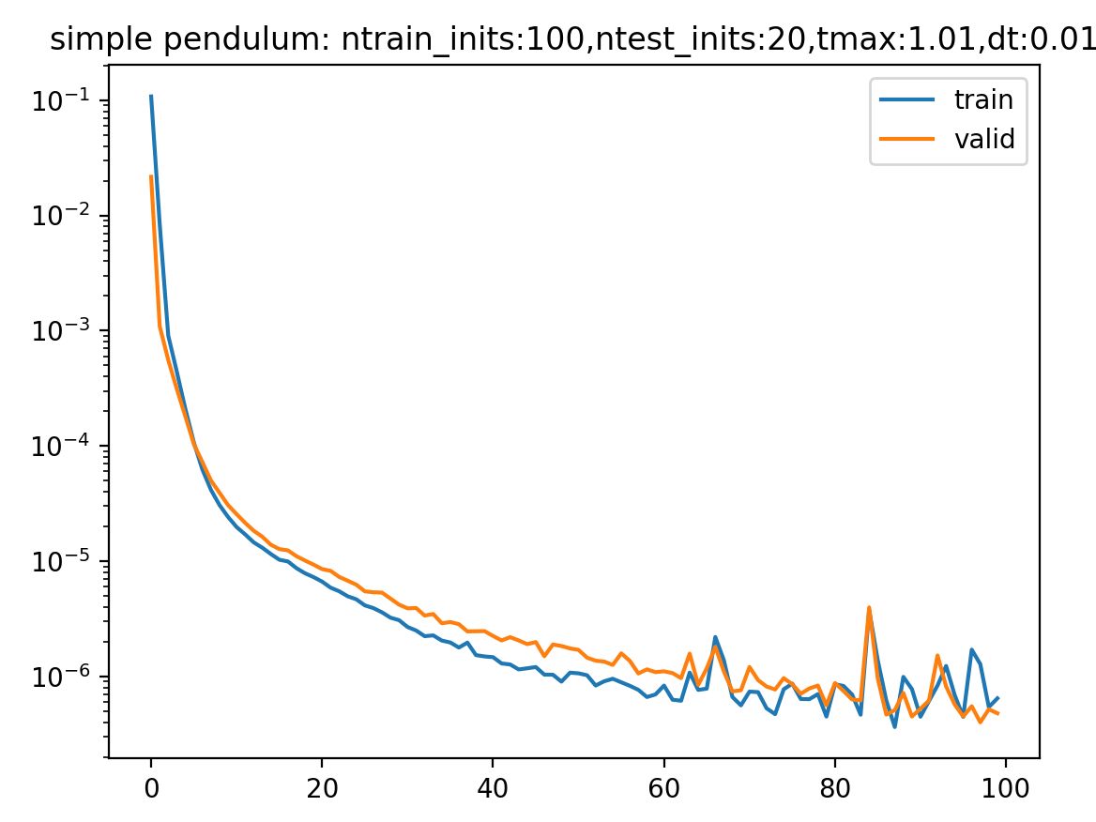
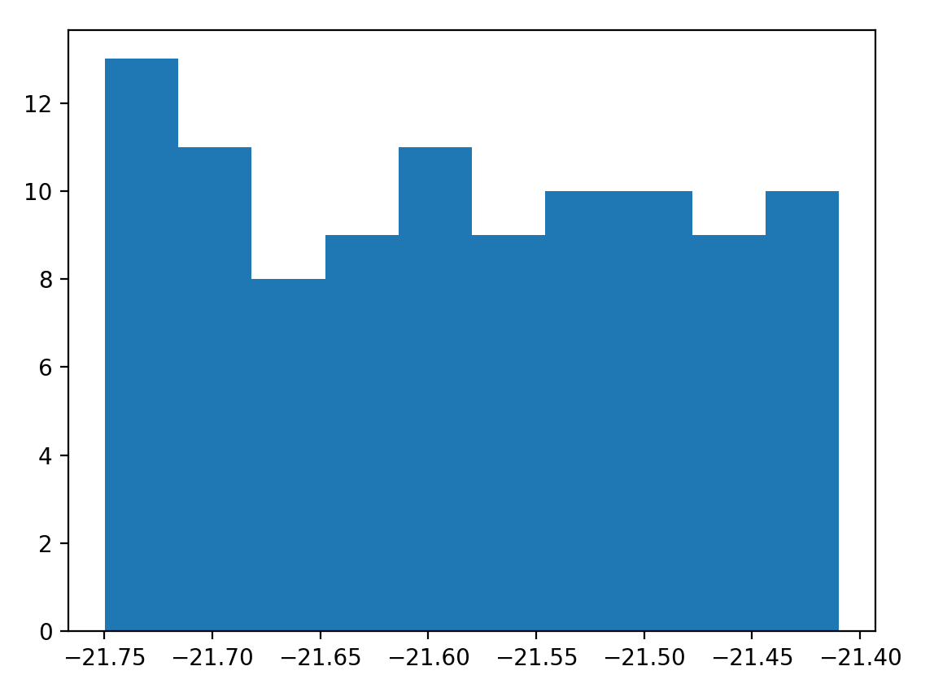
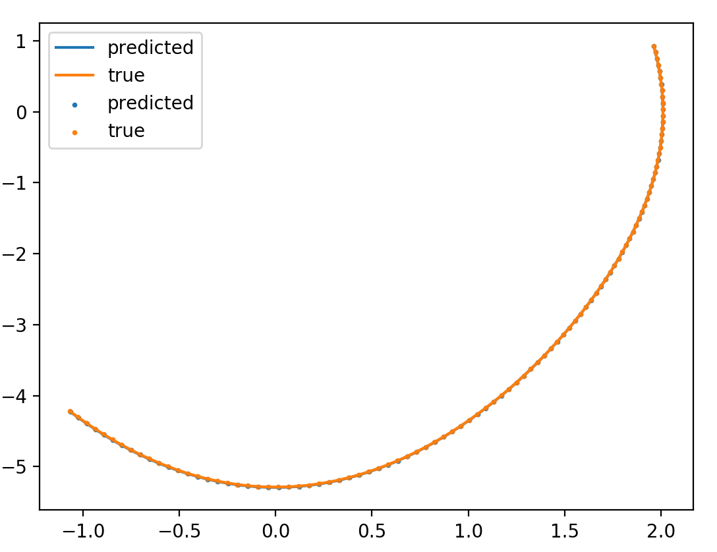
integrator/no energy/ no dH/dt

Slide 5
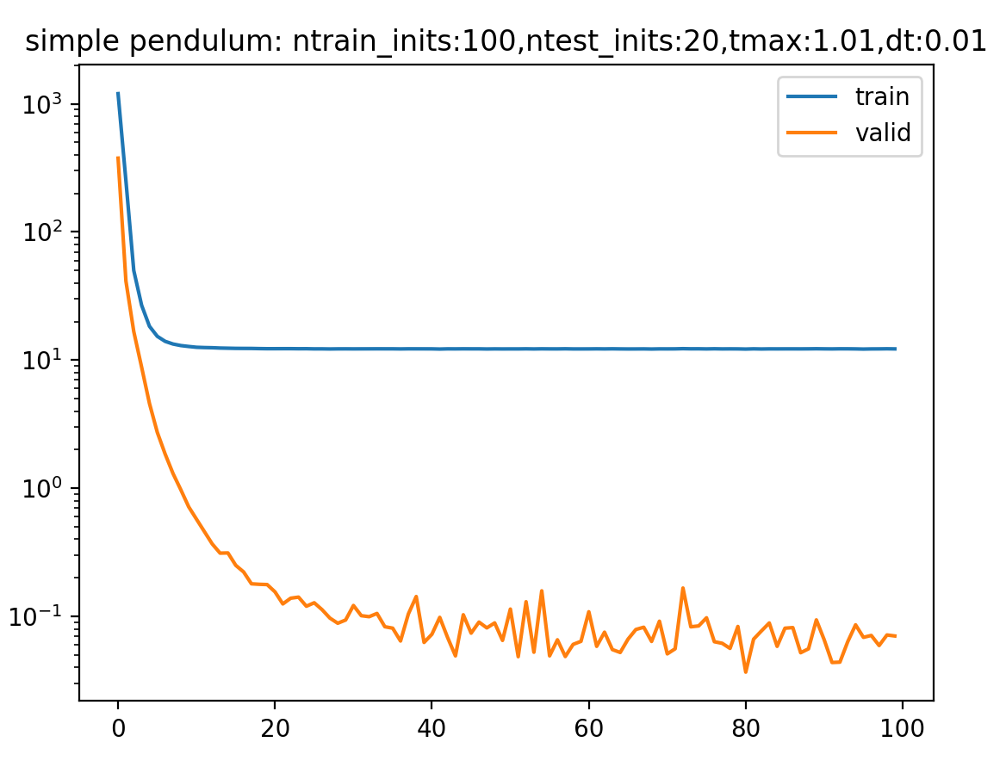
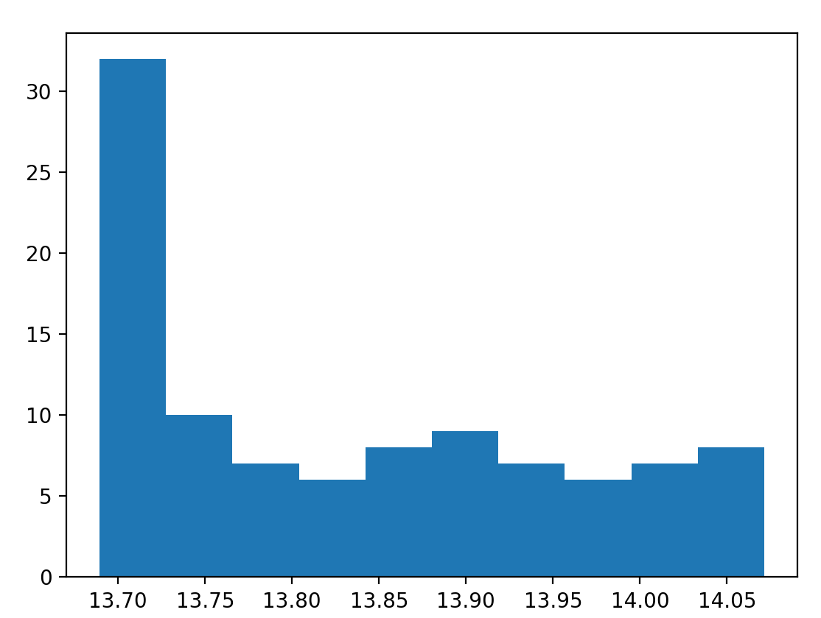
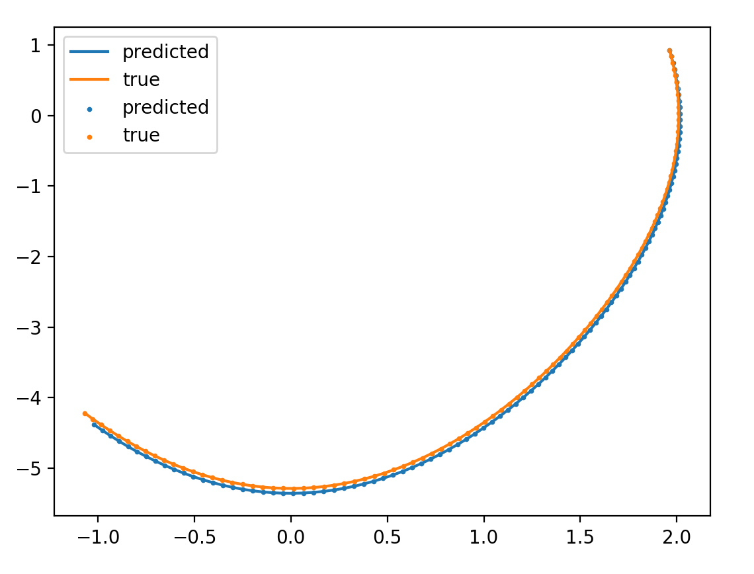
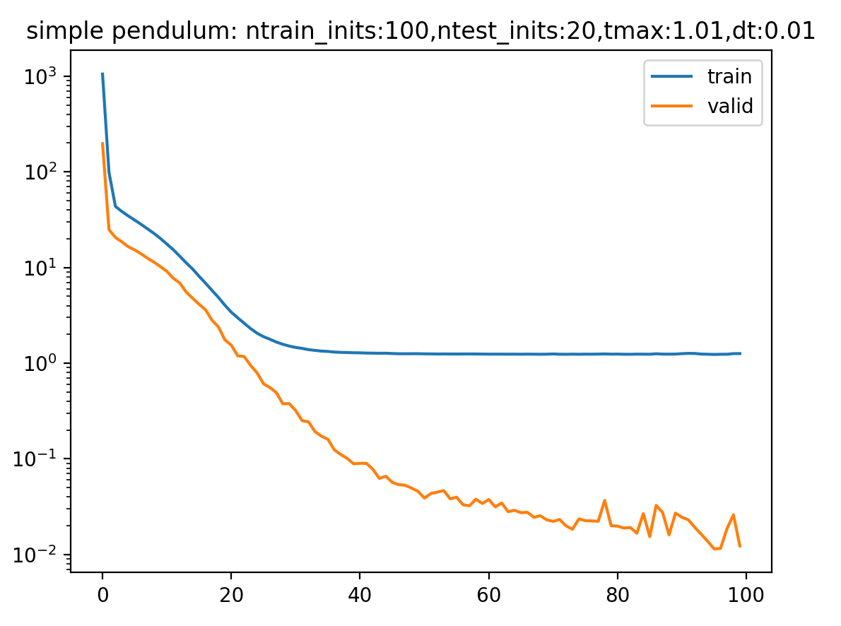
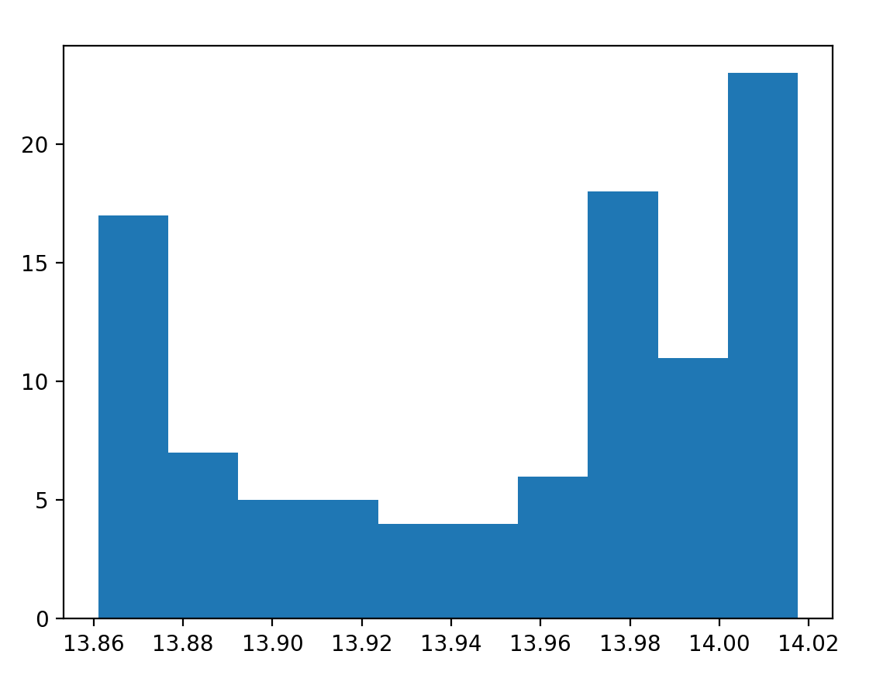
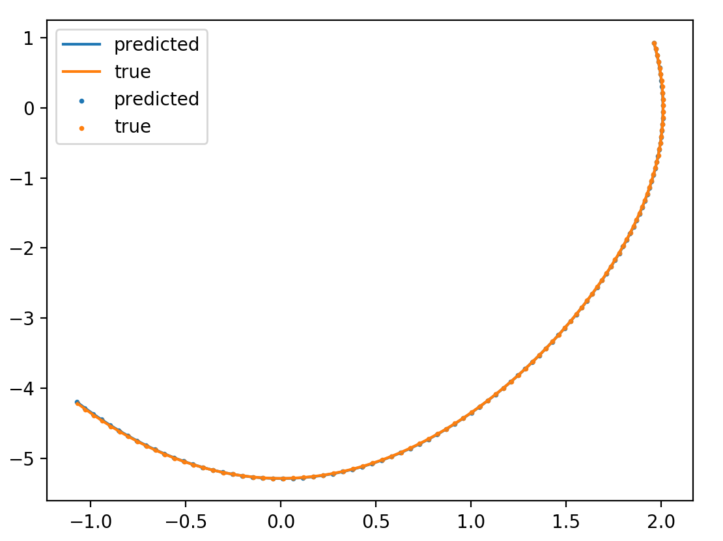
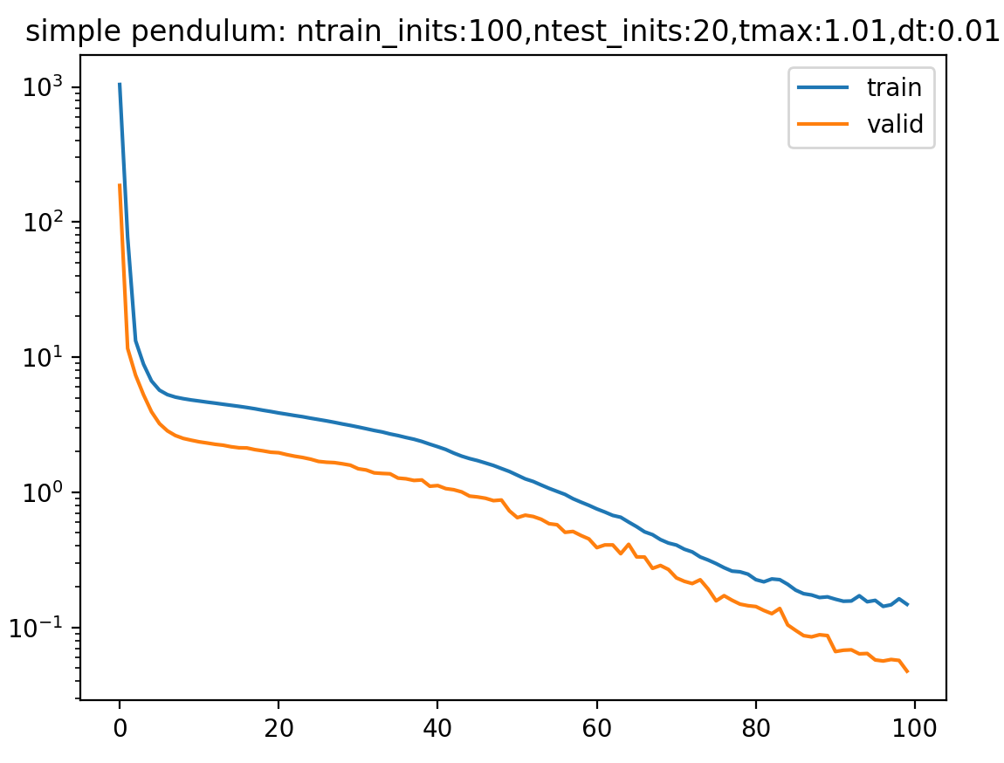
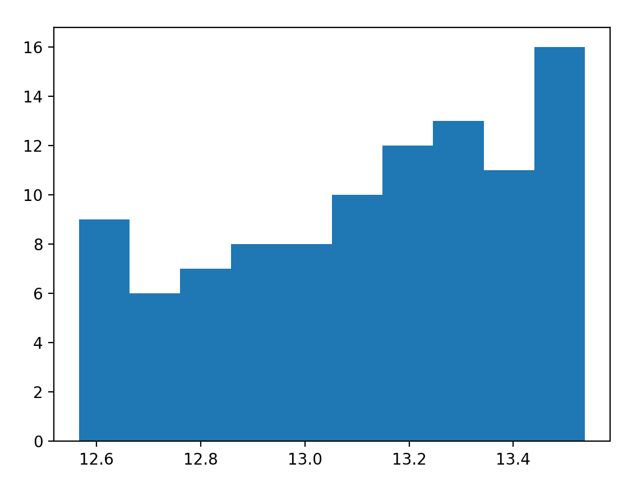
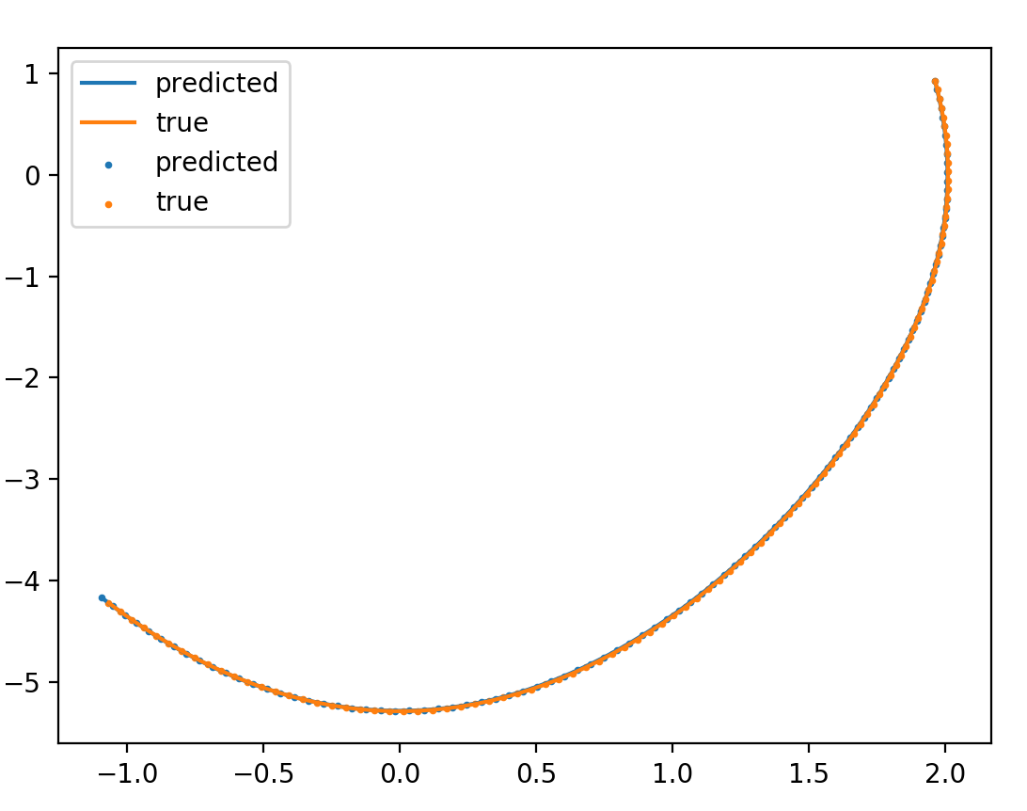
no integrator/energy/ no dH/dt
\beta = 0.01
\beta = 0.001
\beta = 0.0001

Slide 6
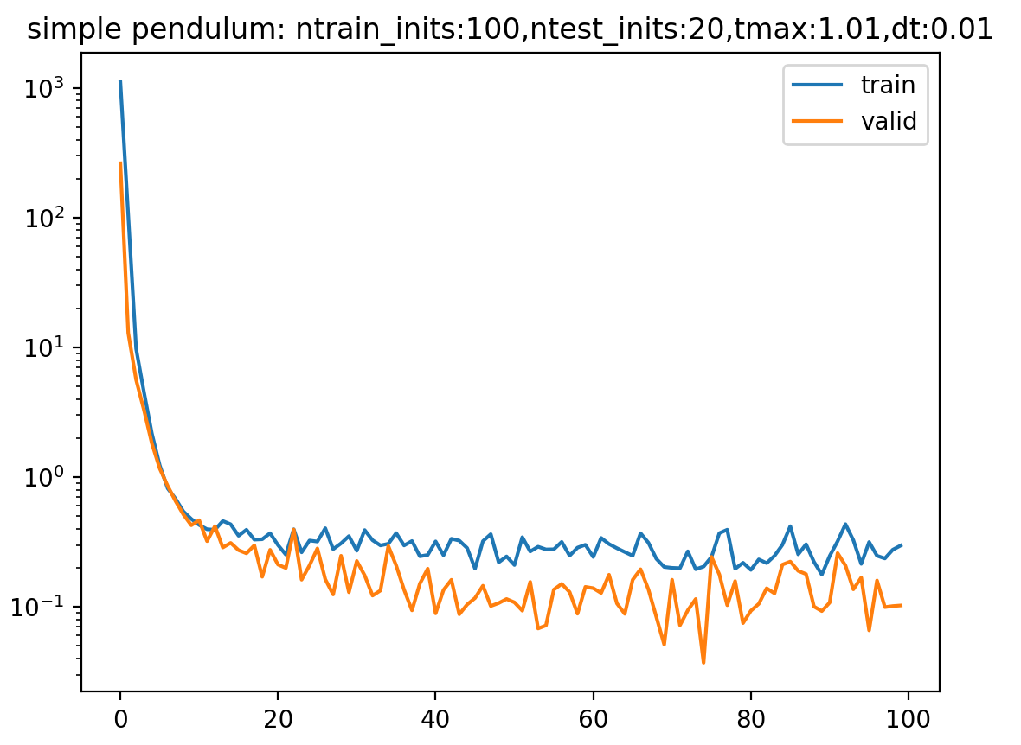
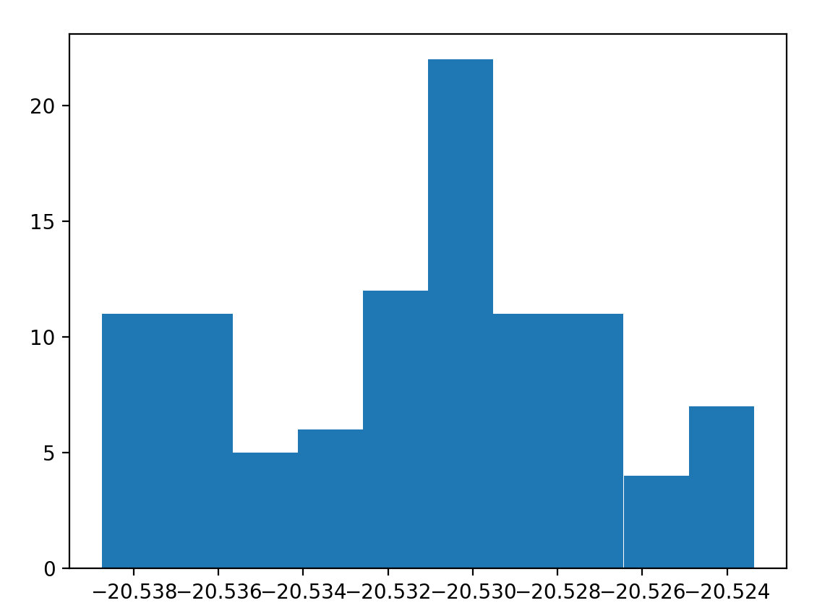
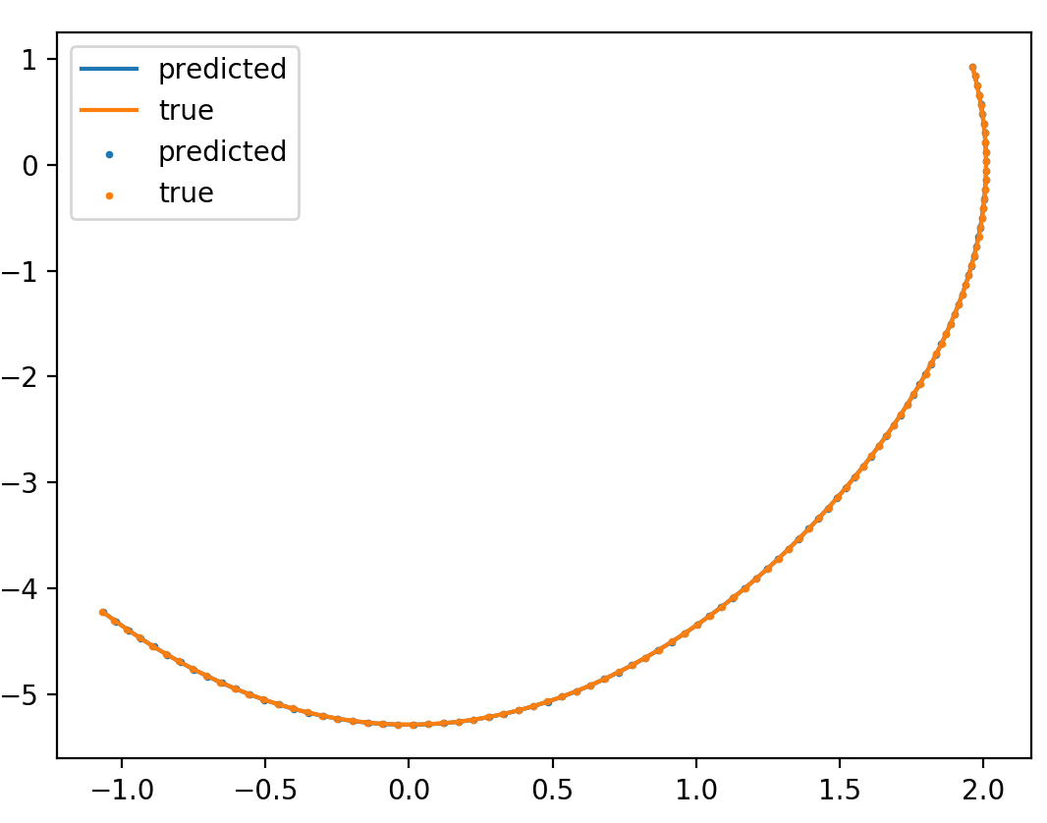
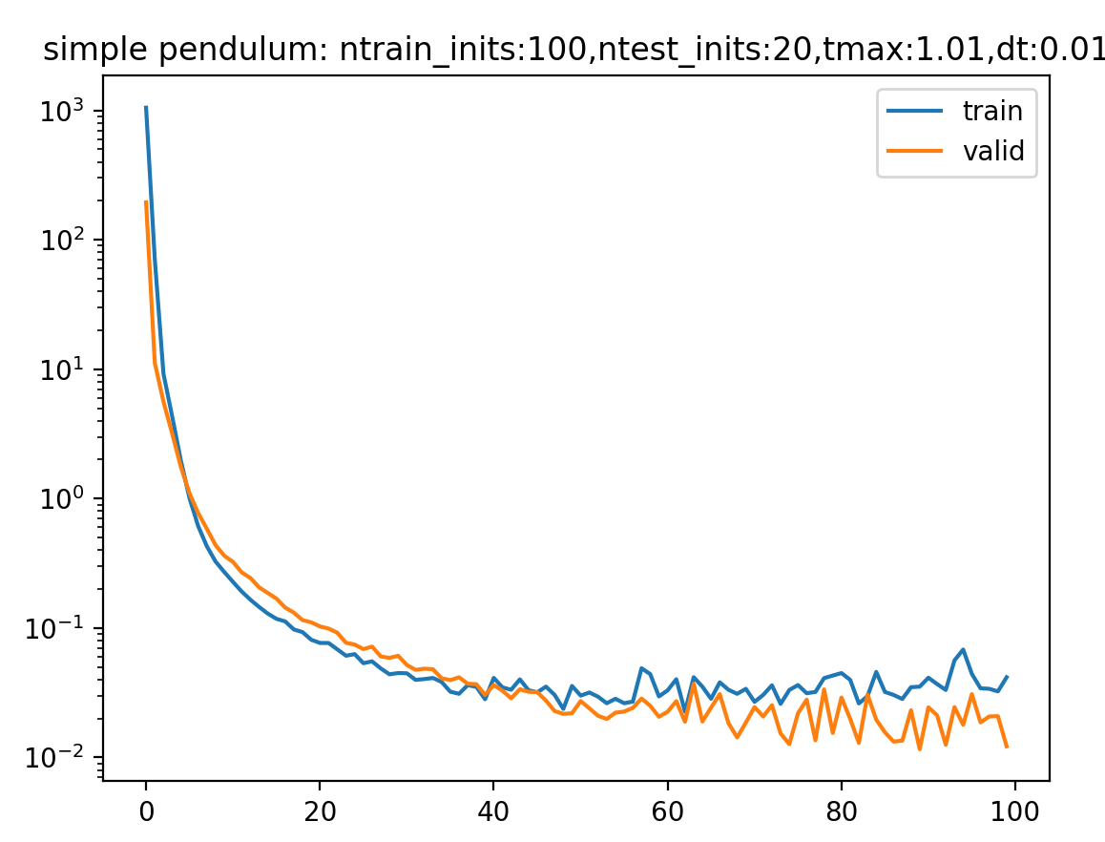
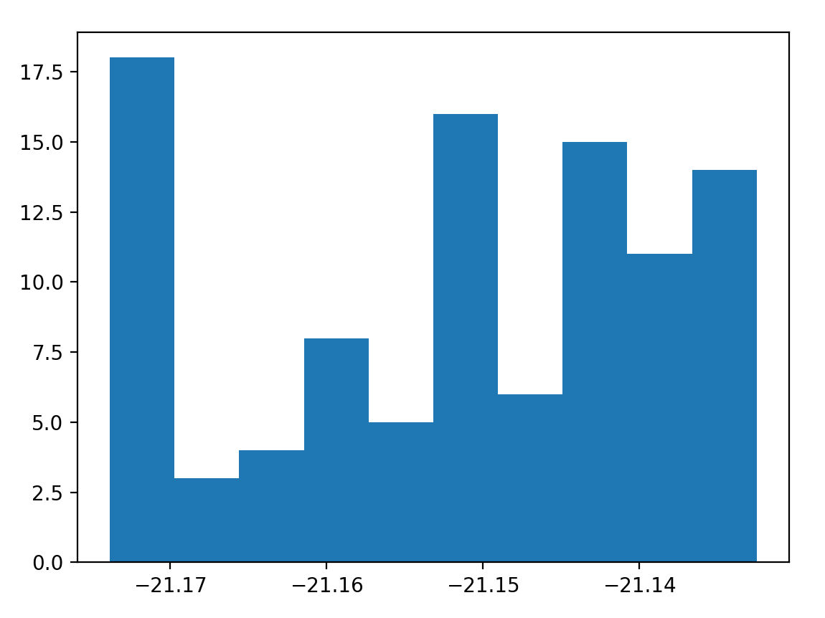
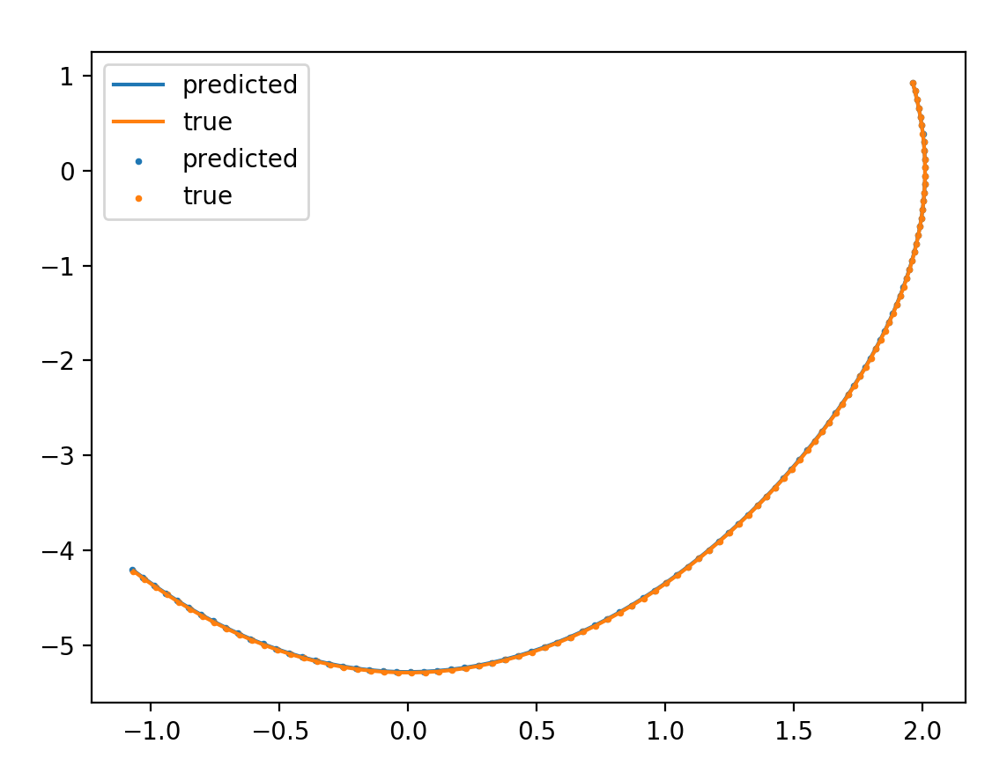
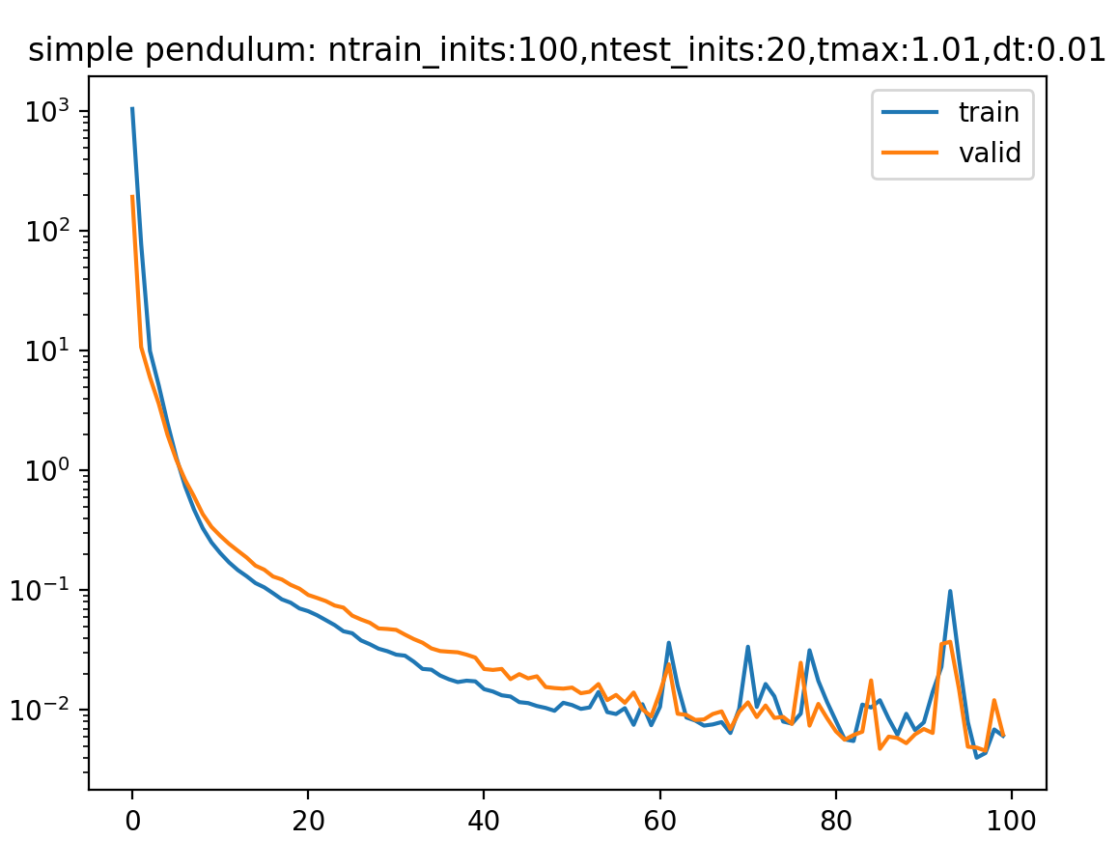
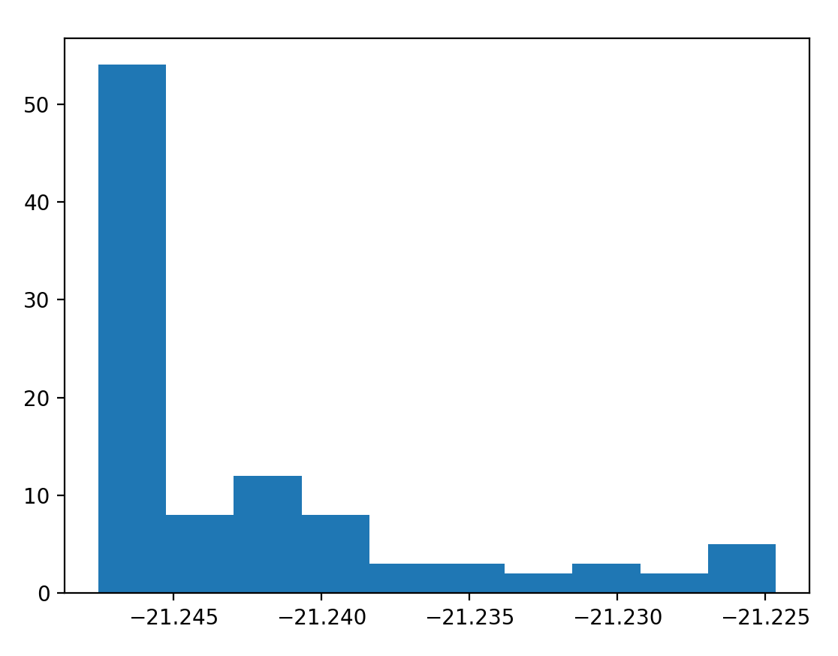
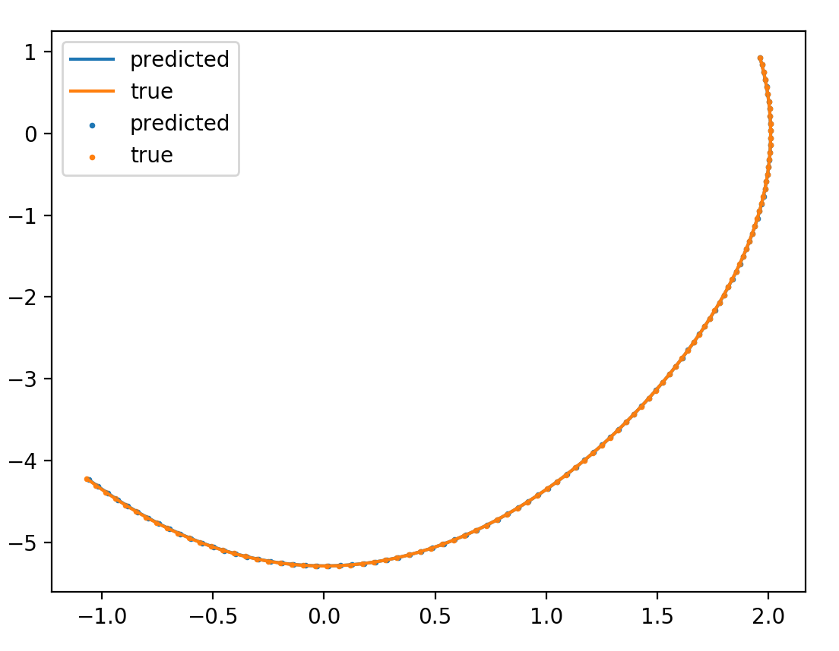
no integrator/no energy/ dH/dt
\gamma = 1
\gamma = 0.1
\gamma = 0.01

Slide 7
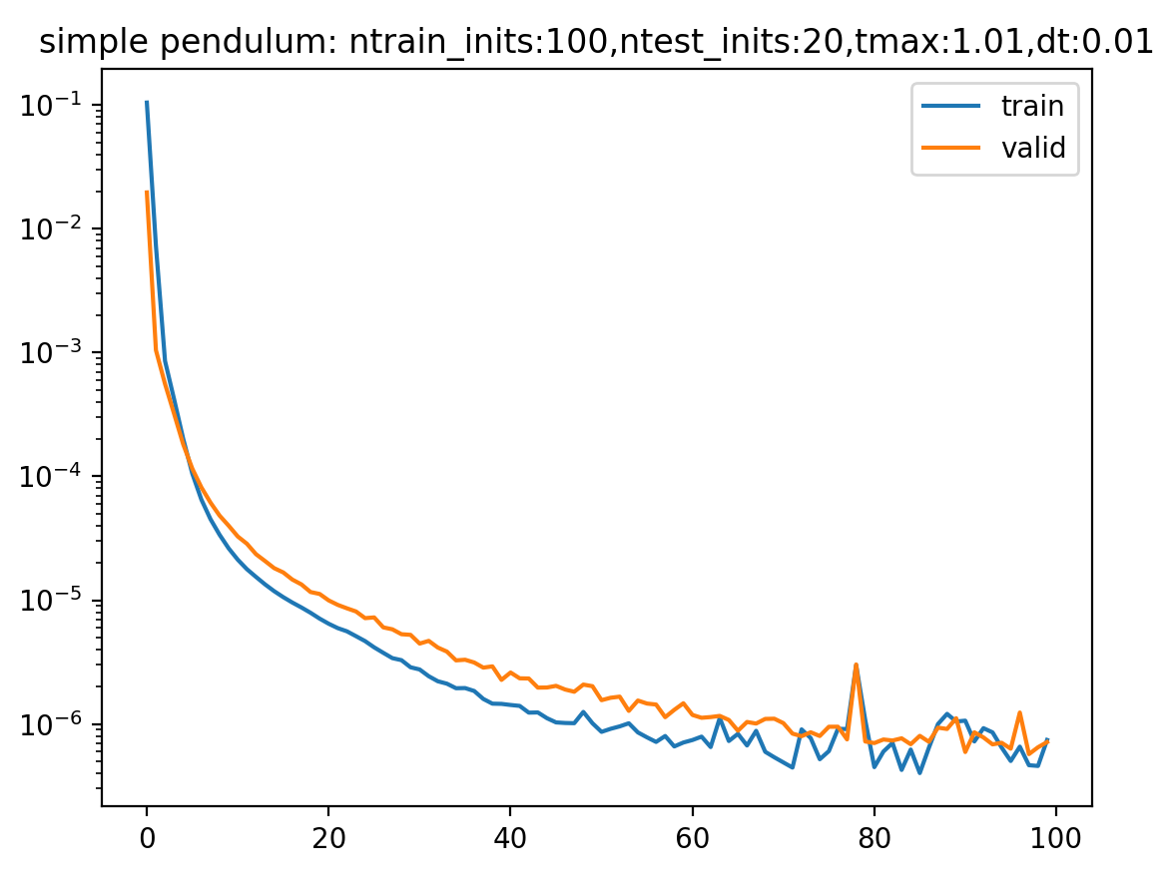
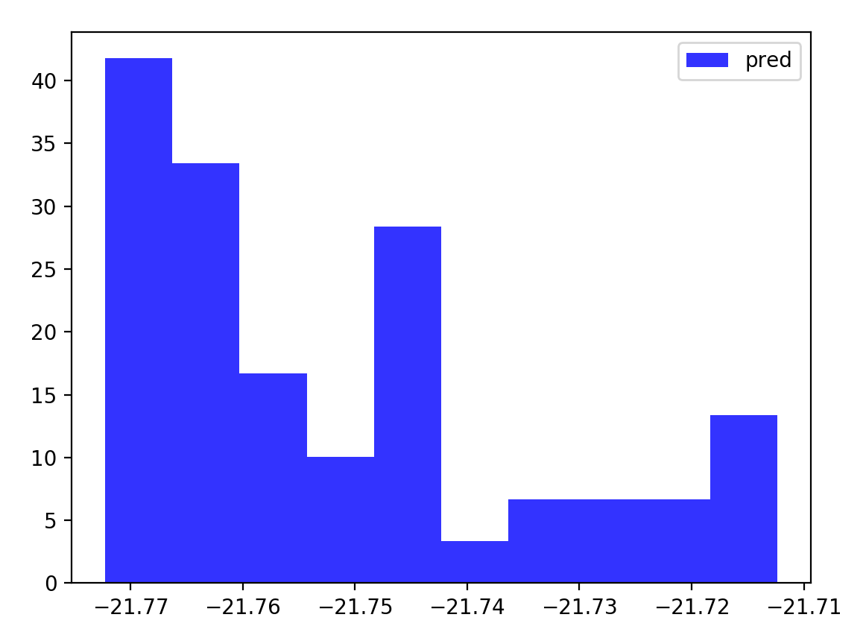
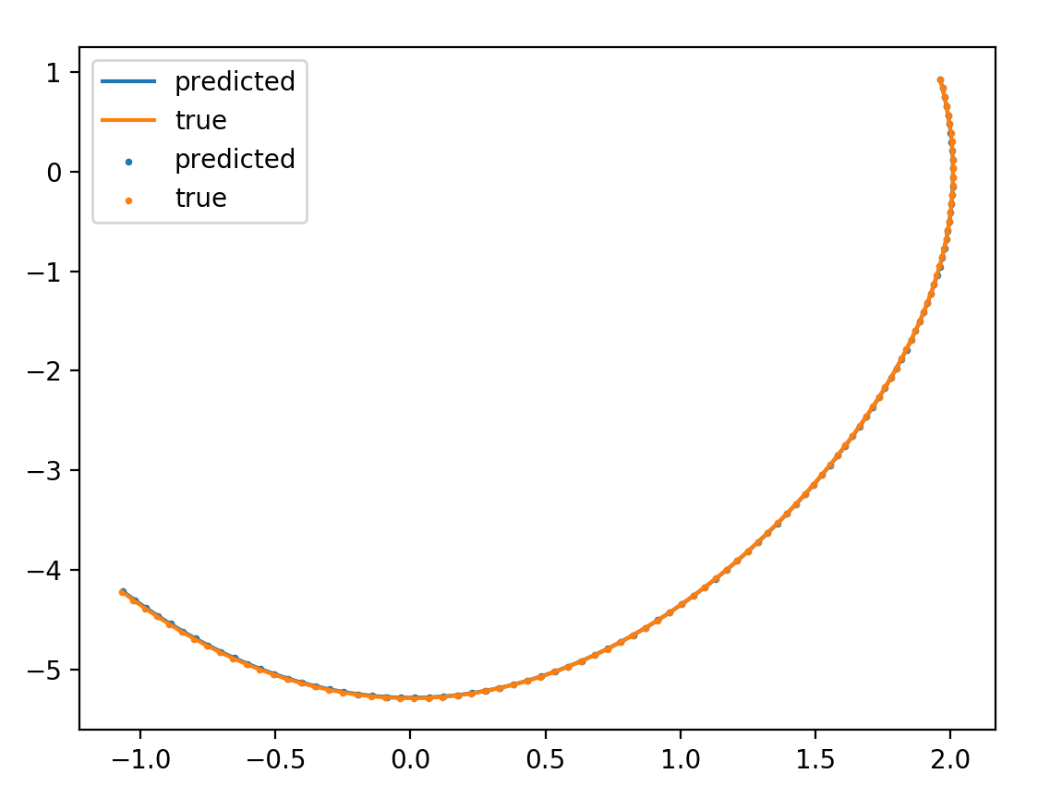
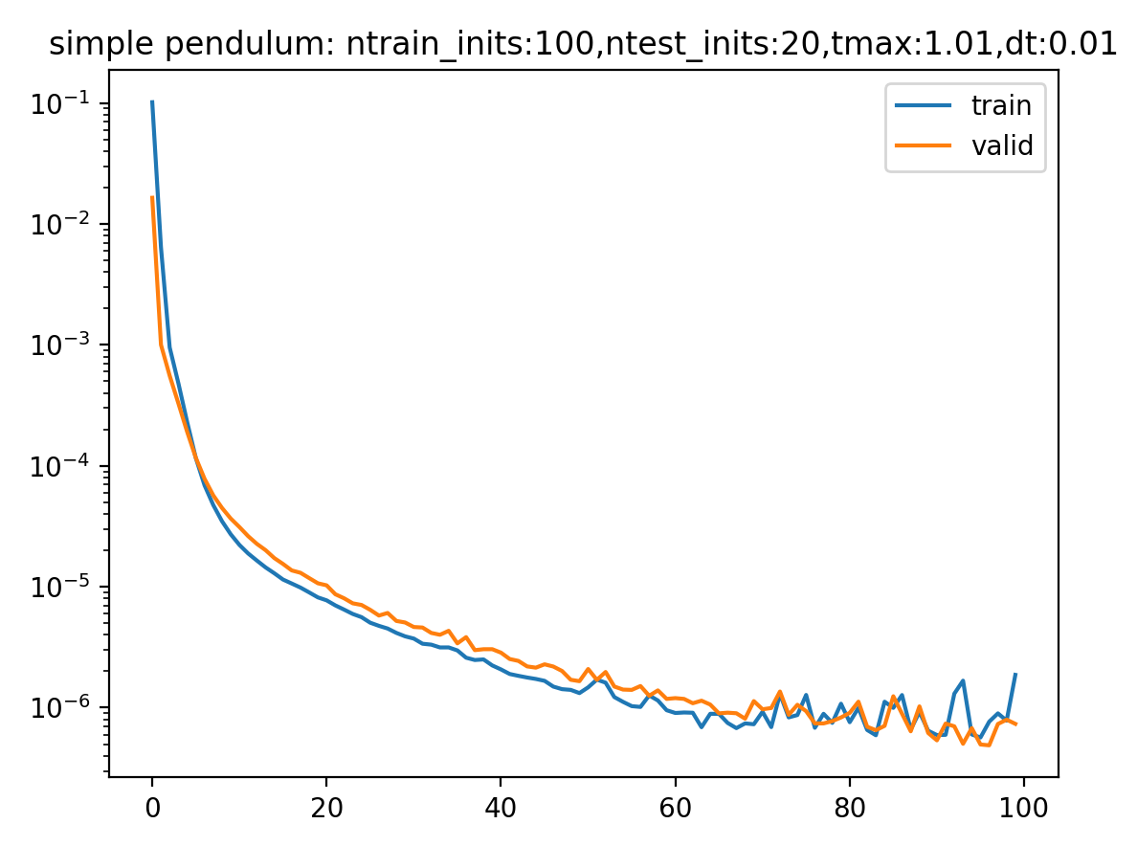
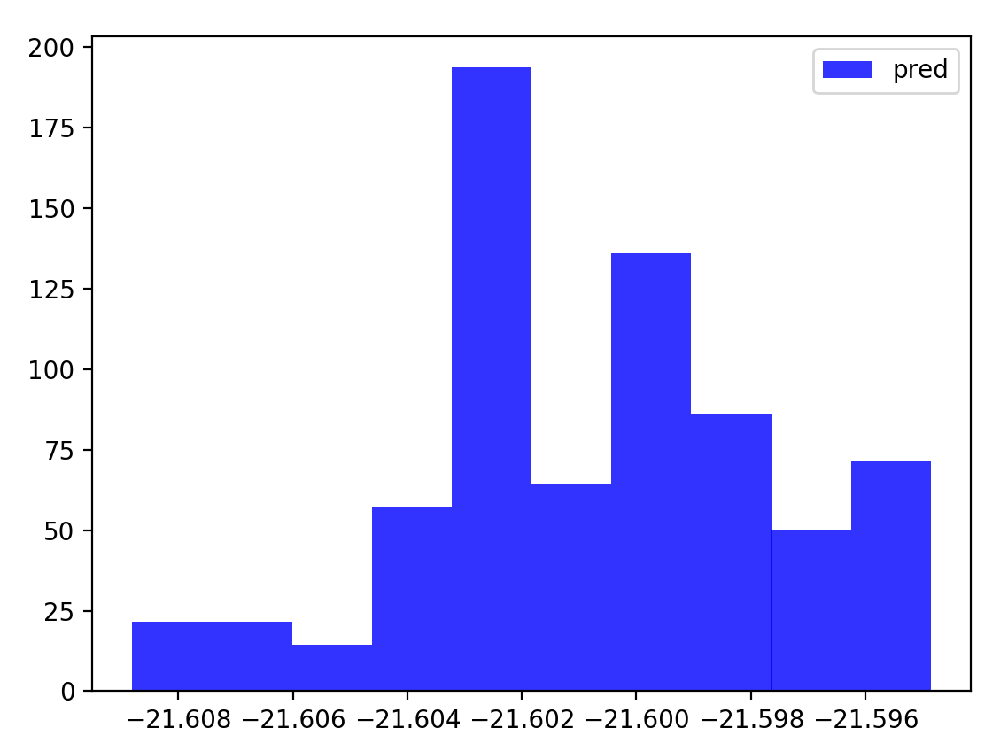
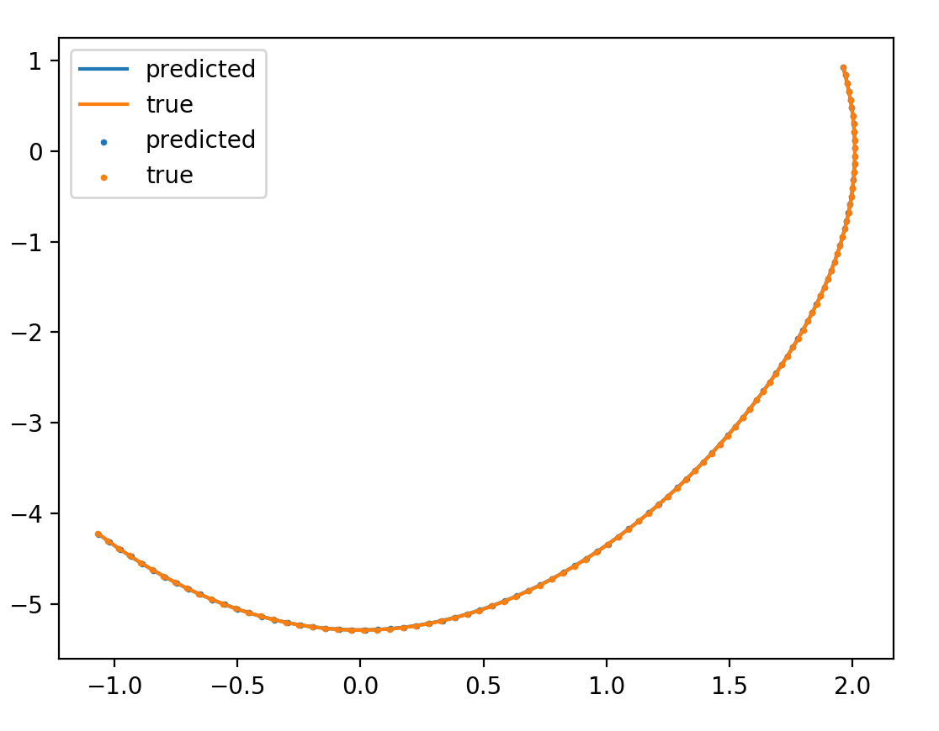
integrator/no energy/ dH/dt
\gamma = 1e-8
\gamma = 1e-6

Slide 8
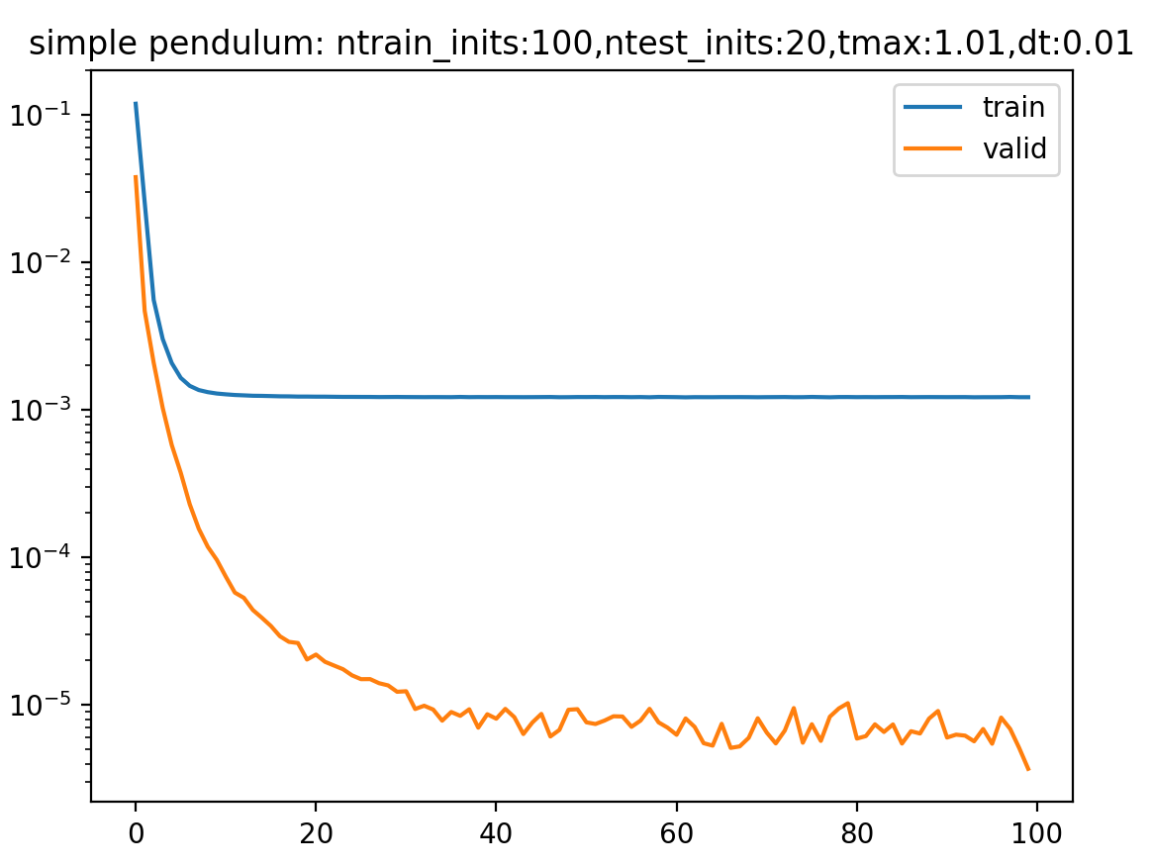
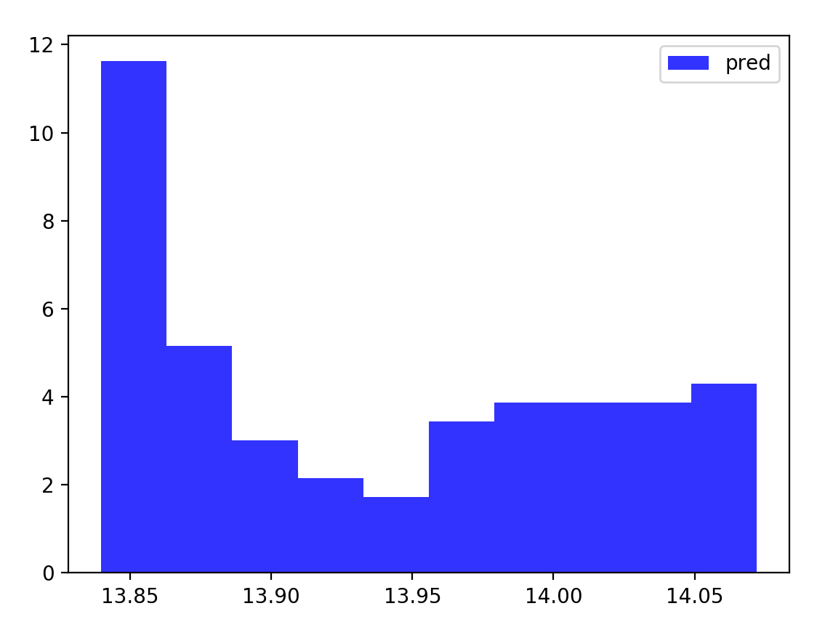
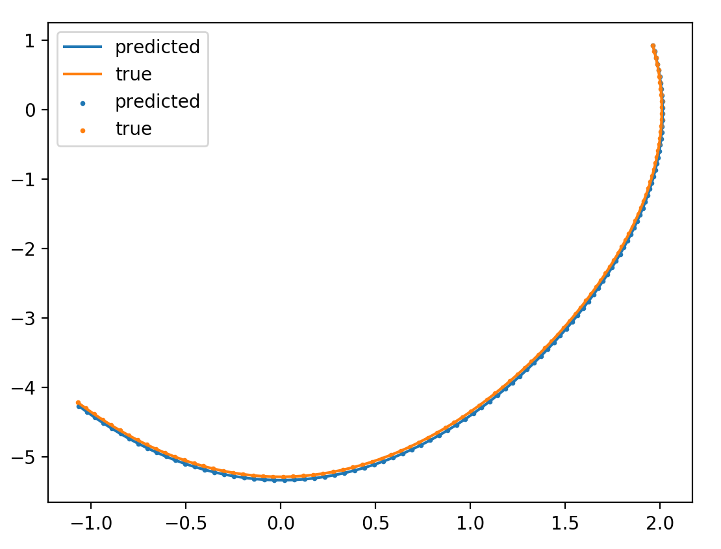
integrator/energy/ no dH/dt
\beta = 1e-6

Slide 9
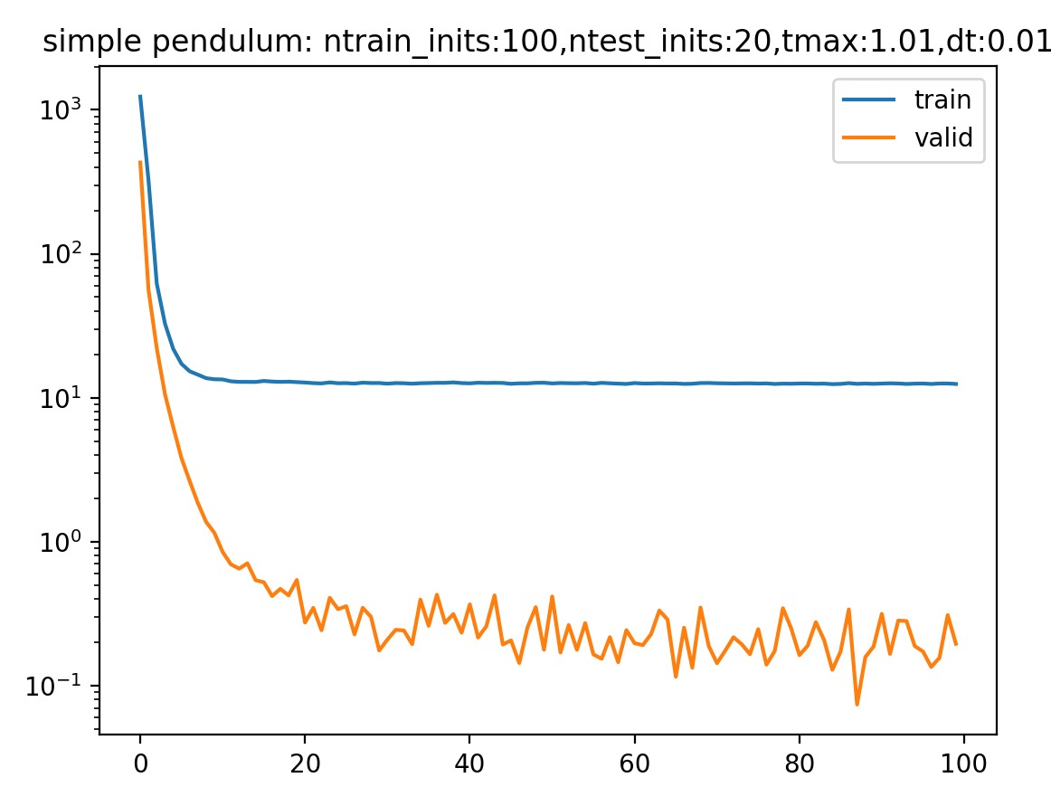
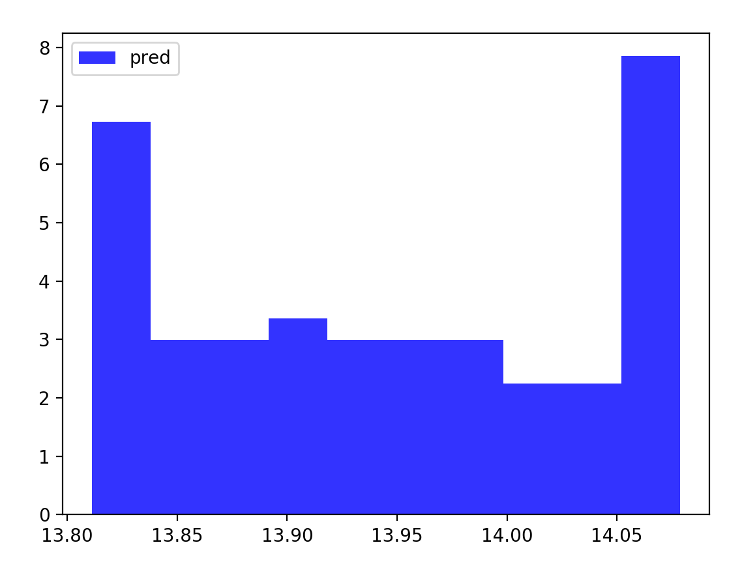
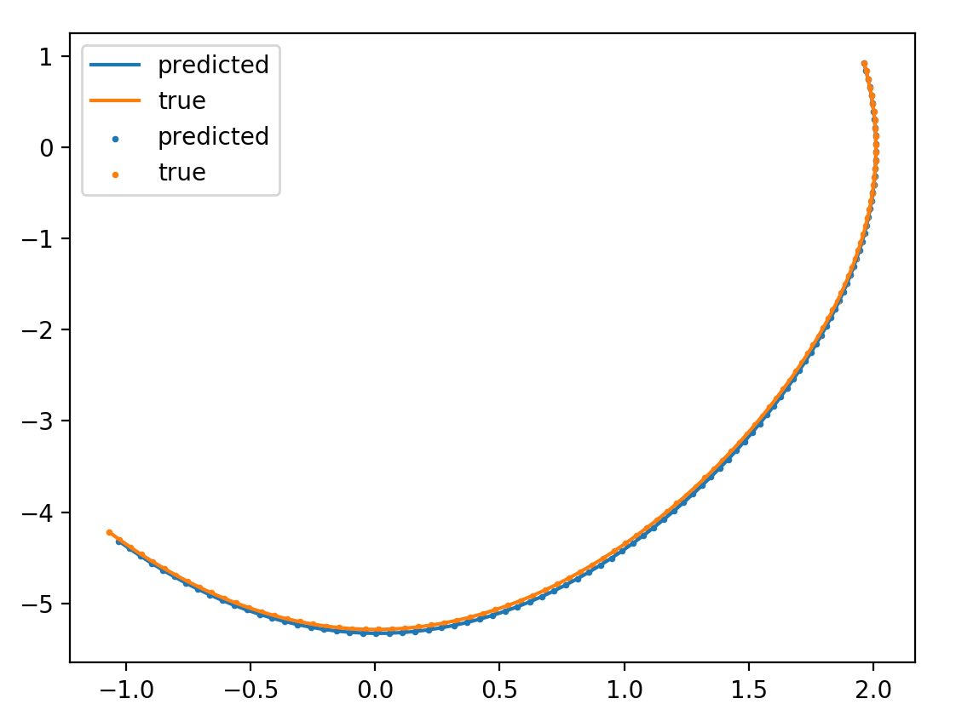
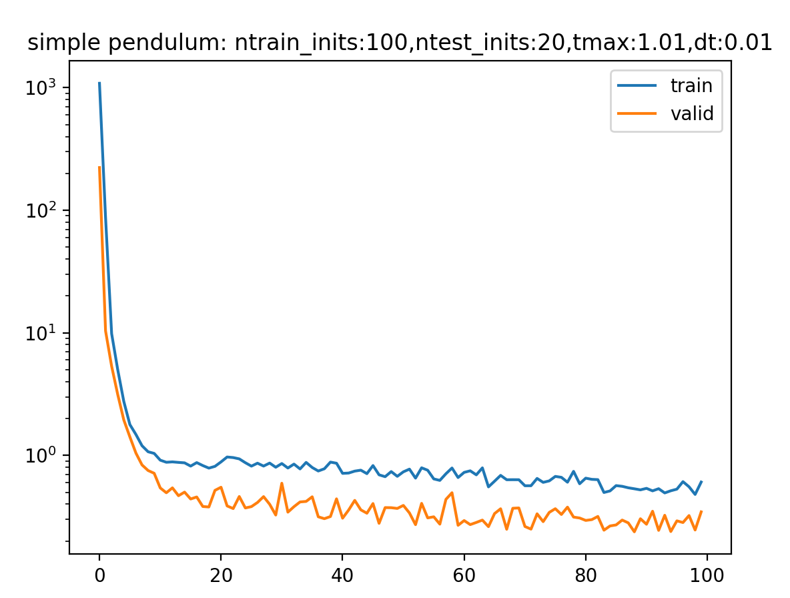
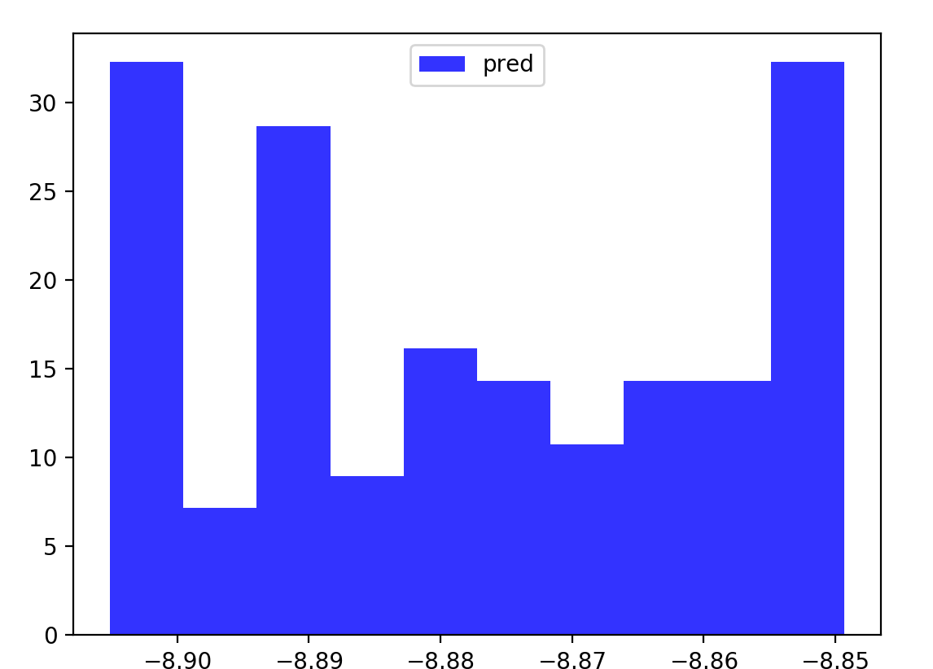
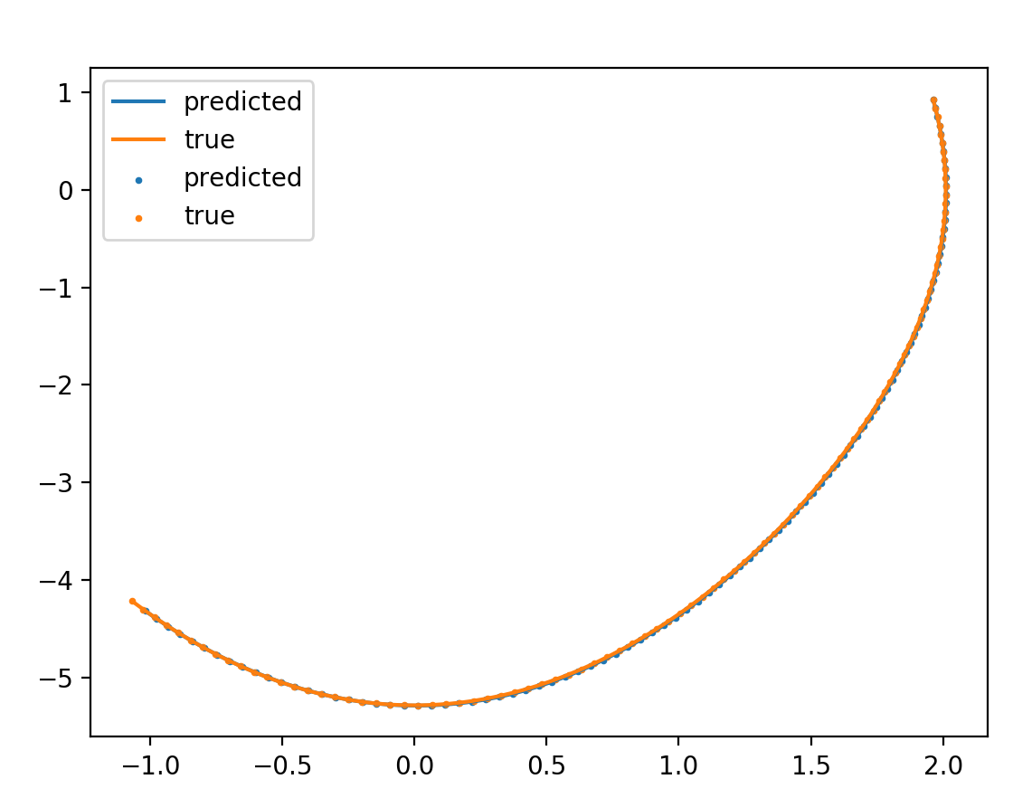
No integrator/energy/ dH/dt
\beta = 1e-2
\gamma = 1
\beta = 1e-5
\gamma = 1

Slide 10
Double Pendulum
Coordinate aware

Slide 11
Physics simulator with RK(5)4 integrator

Slide 12
Time dependent systems
Current Review:
We saw that once we include time, HNN struggles to conserve energy
Therefore we need dh/dt
Which explains why we saw better performance with the term
However, compared to the above, hnn alone without t does much better
Even after hyperparameter tuning
I then tested HNN with a forced pendulum
Results look promising
But just not there
H = 1/2 kq^2 + ½ p^2/m + qF(cos(wt))
dH/dq = pdot = qddot = -q – F(cos(wt)) + (damping)

Slide 13
Time dependent systems
Run experiment with only 1 training point
Test convergence
Notice that additional hidden layer does help when only 1 trajectory is provided
When more training points are added, training not improving
Also notice learning is highly sensitive to the amplitude of forcing?
Run experiment where we use mass-spring system
Noticing similar behaviour with angular data that we had with the double pendulum
Notice that if we do use mass-spring systems with forcing then we get good results
The only papers which propose tackling angular data involve directly embedding/enforcing S1 manifold
VIN paper
Symp ODEN
Mass-spring with damping and forcing – needs testing
High frequency oscillations are much harder to learn
Issue with learning damping

Slide 14
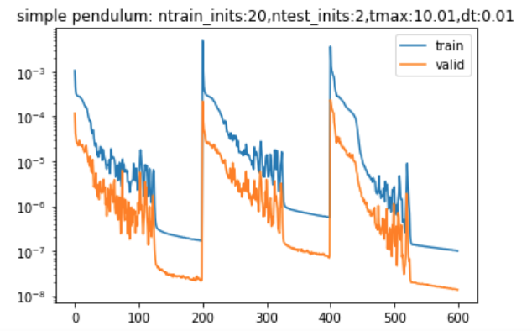
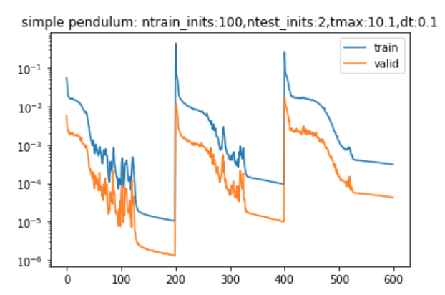
Time-Dependent Systems (learning the forcing term)
dt=0.01,tmax=10.01,n=20
dt=0.1,tmax=10.1,n=100

Slide 15
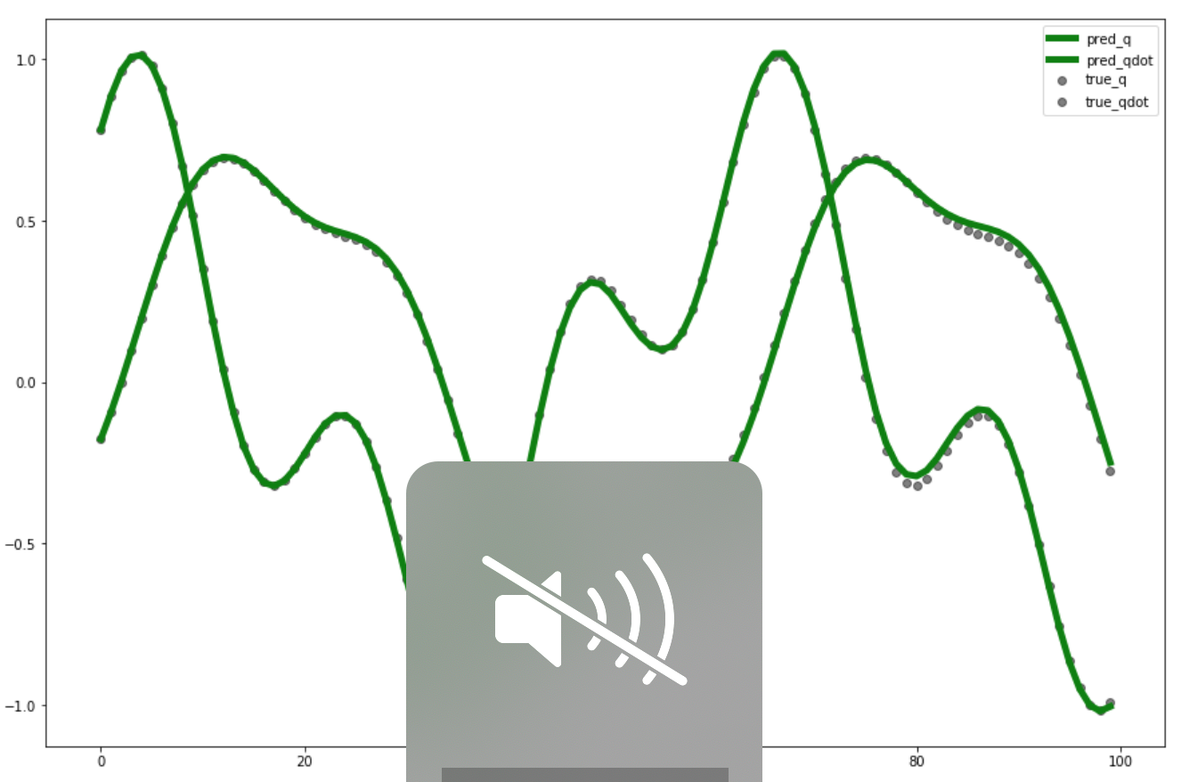
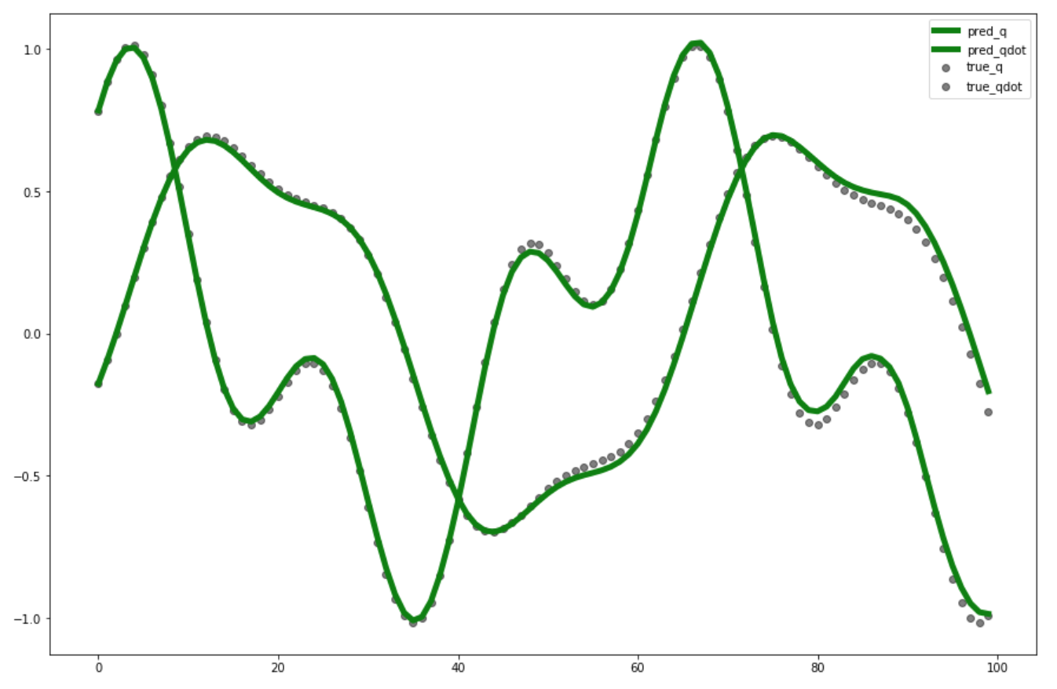
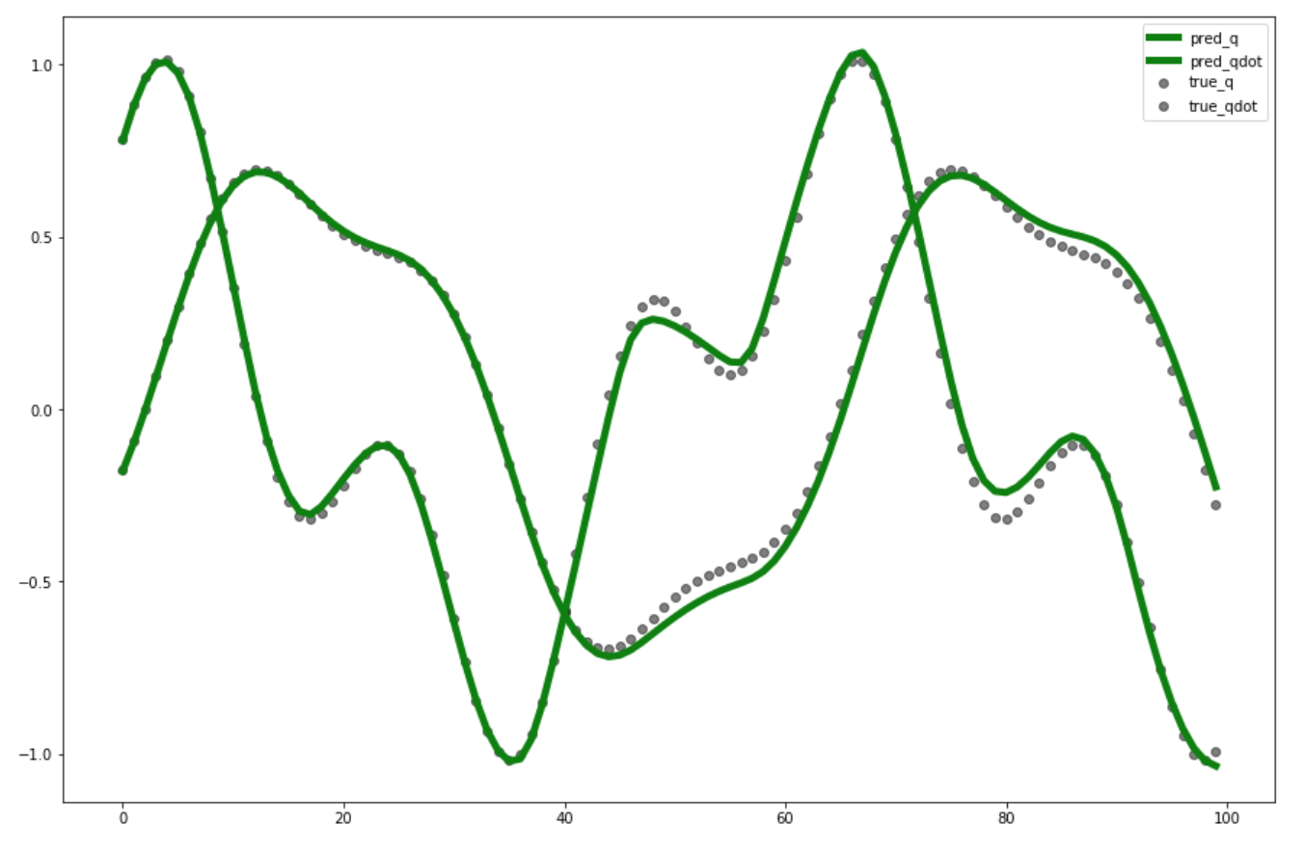
N=100,dt=0.1,tmax=10.1
classical
Type I
Type II

Slide 16
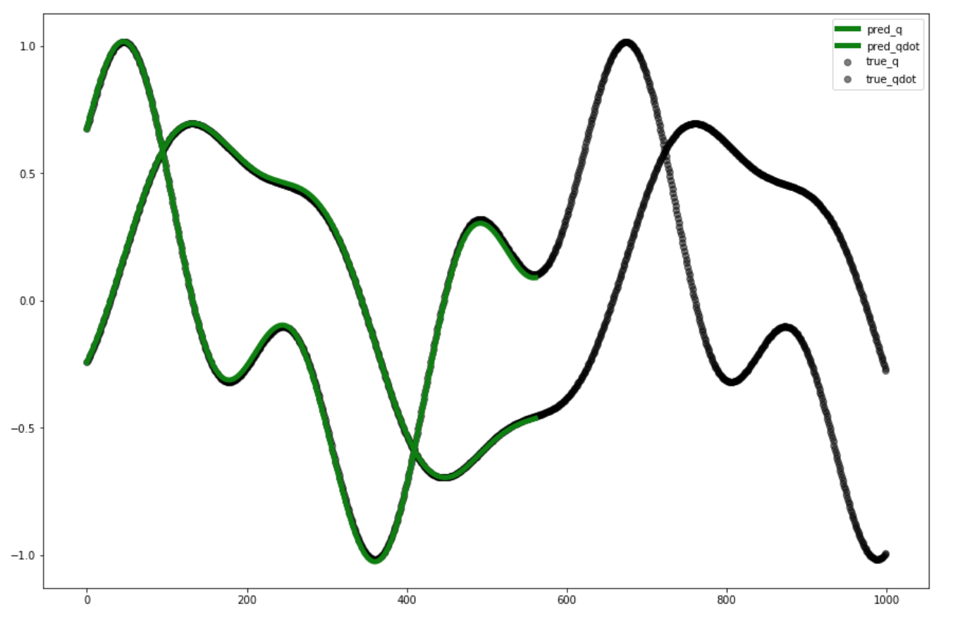
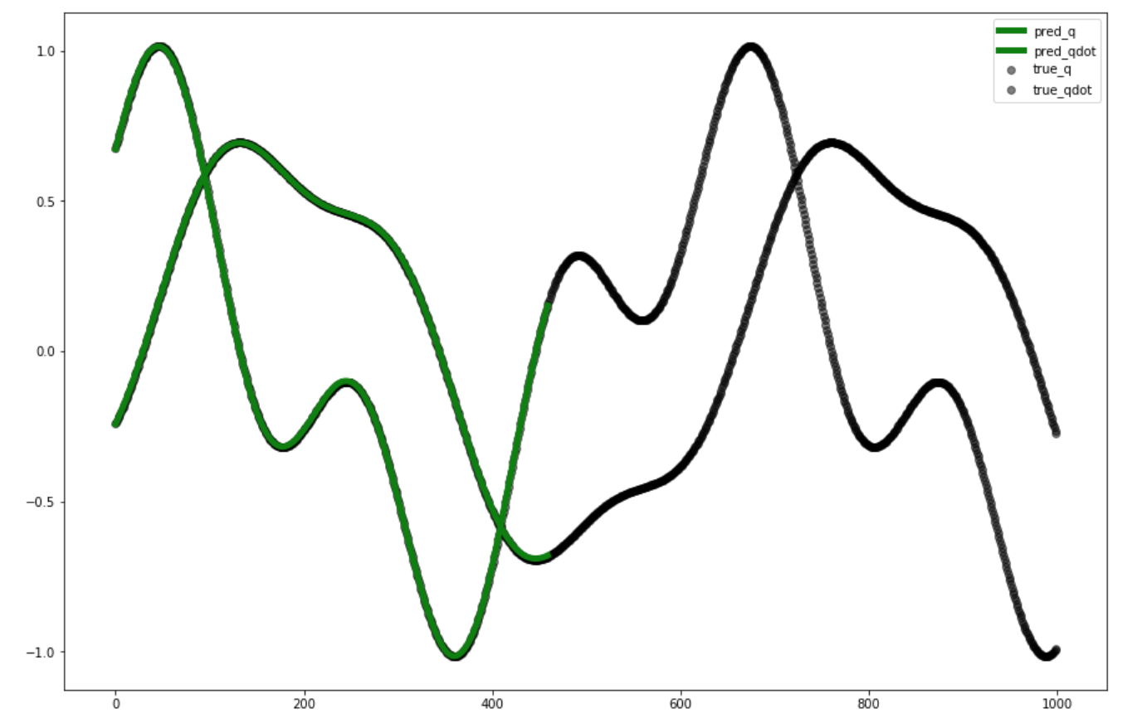
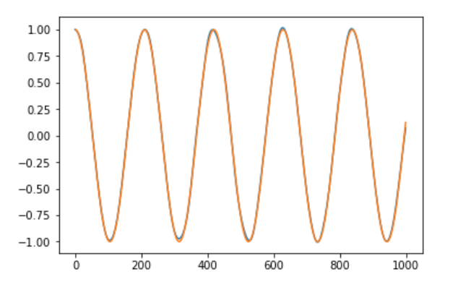
N=20,dt=0.01,tmax=10.01
classical
Type II
Notes:
Not all trajectory length shown since inference is slow

Slide 17
questions
Why does learning the forcing not outperform classical much more?
How useful is it to learn force?
What happens if we include damping?

Slide 18
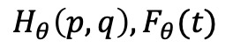
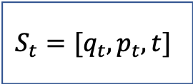
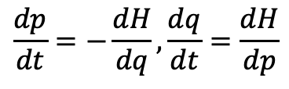





Architectures
$$S_{t}=[q_{t},p_{t}]$$
$$\frac{dp}{dt}=−\frac{dH}{dq},\frac{dq}{dt}=\frac{dH}{dp}$$
$$H_{θ}(p,q)$$
Classical HNN
$$S_{t}=[q_{t},p_{t},t]$$
$$\frac{dp}{dt}=−\frac{dH}{dq},\frac{dq}{dt}=\frac{dH}{dp}$$
$$H_{θ}(p,q,t)$$
TDHNN type I
$$S_{t}=[q_{t},p_{t},t]$$
$$\frac{dp}{dt}=−\frac{dH}{dq}+F_{θ}(t),\frac{dq}{dt}=\frac{dH}{dp}$$
$$H_{θ}\left(p,q\right), F_{θ}(t)$$
TDHNN type II

Slide 19









$$S_{t}=[q_{t},p_{t},t]$$
$$\frac{dp}{dt}=−\frac{dH}{dq},\frac{dq}{dt}=\frac{dH}{dp}$$
$$H_{θ}(p,q,t)$$
TDHNN type I
$$S_{t}=[q_{t},p_{t},t]$$
$$\frac{dp}{dt}=−\frac{dH}{dq}+F_{θ}(t),\frac{dq}{dt}=\frac{dH}{dp}$$
$$H_{θ}\left(p,q\right), F_{θ}(t)$$
TDHNN type II
$$S_{t}=[q_{t},p_{t},t]$$
$$\frac{dp}{dt}=−\frac{dH}{dq},\frac{dq}{dt}=\frac{dH}{dp}$$
$${H_{tot}=H}_{θ}\left(p,q\right)+qF_{θ}(t)$$
TDHNN type III
$$Loss={\left|\frac{dp}{dt}+\frac{dH}{dq}\right|}_{2}^{2}+{\left|\frac{dq}{dt}−\frac{dH}{dp}\right|}_{2}^{2}$$

Slide 20



































$$q_{t}$$
$$\hat{\dot{q_{t}}}$$
$$q_{t}$$
classic NN
$${\hat{H}}_{tot}=\hat{H}$$
$$p_{t}$$
$$\hat{\dot{p_{t}}}$$
$$p_{t}$$
$$\hat{H}$$
$$\frac{d\hat{H}}{dp_{t}}=\hat{\dot{q_{t}}}$$
$$t$$
Time-dependent HNN (type I)
$$\hat{F}$$
$$D(p)$$
$$\frac{d\hat{H}}{dq_{t}}=−\hat{\dot{p_{t}}}+σ(w)F+σ(w)D(p)$$
$$q_{t}$$
$$\frac{d\hat{H}}{dp_{t}}=\hat{\dot{q_{t}}}$$
$$t$$
Hamiltonian NN
$$\hat{F}$$
$$p_{t}$$
$$\hat{H}$$
$$\frac{d\hat{H}}{dq_{t}}=−\hat{\dot{p_{t}}}$$
$$q_{t}$$
$$q_{t}$$
$$\frac{d\hat{H}}{dp_{t}}=\hat{\dot{q_{t}}}$$
$$p_{t}$$
$$\hat{H}$$
$$\frac{d\hat{H}}{dp_{t}}=\hat{\dot{q_{t}}}$$
$$p_{t}$$
$${\hat{H}}_{tot}=$$
$$\hat{H}+q\hat{F}$$
Time-dependent HNN
$$\hat{H}$$
$$\frac{d\hat{H}}{dq_{t}}=−\hat{\dot{p_{t}}}$$
Time-dependent HNN (type II)
$$\frac{d\hat{H}}{dq_{t}}=−\hat{\dot{p_{t}}}$$
$$t$$
$$t$$
$$Loss={\left|\dot{p_{t}}−\hat{\dot{p_{t}}}\right|}_{2}^{2}+{\left|\dot{q_{t}}−\hat{\dot{q_{t}}}\right|}_{2}^{2}$$
$$\hat{F}$$
$$σ(w)\hat{F}$$
Autograd output w.r.t. input
Add NN outputs (potentially scaled by weights/inputs)

Slide 21





Problem I: simple mass spring
State rollout MSE across 25 test sets
No force, no noise
Tmax = 6.1
Dt = 0.1
25 train, 25 test
Lr:1e-3,wdecay:1e-4,h=200

Slide 22



Problem I: simple mass spring
No force, no noise
Tmax = 6.1
Dt = 0.1
25 train, 25 test
*No bias terms
MSE

Slide 23




Problem I: simple mass spring
No force, *noise on both $q,p and \dot{q},\dot{p}$
Tmax = 6.1
Dt = 0.1
25 train, 25 test
*No bias terms
T = 6.1
T = 12.1
(generalizes as well as HNN!)

Slide 24




Problem II: forced mass spring
MSE
On 10 datasets rolled out to 2s
F=cos(3t), no noise,Tmax = 10.01.Dt = 0.01.25 train, 25 test, bias

Slide 25



Problem III: forced mass spring
F=cos(3t)cos(6t), no noise,Tmax = 10.01.Dt = 0.01, 25 train, 25 test, no bias, no weight_decay

Slide 26



Problem IV: Painleve
H=p^2/2-2q^3-qt, no noise, Tmax = 1.1.Dt = 0.1, 25 train, 25 test, no bias, no weight_decay

Slide 27
Next steps
TDHNN 2 is limited to systems where H = T + V + qF
Cannot really solve painleve II/hill schroedinger
Forced pendulum gives us angles – still need to resolve this!

Slide 28

General Port-Hamiltonian Systems
Dissipative SympODEN has the paper as workshop
Are we aiming for phys/ML conference?
ML to introduce architecture
Phys to introduce graphene example?
Overall, our idea is nice but ideally we need to:
A) have more math or B) have more real-world examples

Slide 29
Experiments (23 Oct – Today)
All centred on figuring out how to simultaneously kill F in unforced and keep F in forced
Only realistic way found is to have regularization (manually tuneable right now)
We can recover HNN and forced HNN
Our forces learned in the duffing seem to be offset by some small delta
The math does not check out – we should not be learning a scalar offset!
We

Slide 30
























$$q_{t}$$
$$q_{t}$$
$$\hat{\dot{q_{t}}}$$
$$\hat{\dot{q_{t}}}$$
Classic NN
Baseline NN
$$p_{t}$$
$$p_{t}$$
$$\hat{\dot{p_{t}}}$$
$$\hat{\dot{p_{t}}}$$
$$t$$
$$\frac{d{\hat{H}}_{θ_{1}}}{dp_{t}}=\hat{\dot{q_{t}}}$$
$$q_{t}$$
$$\frac{d{\hat{H}}_{θ_{1}}}{dp_{t}}=\hat{\dot{q_{t}}}$$
$$q_{t}$$
$$p_{t}$$
Hamiltonian NN
Time-dependent HNN
$$p_{t}$$
$${\hat{H}}_{θ_{1}}$$
$$\frac{d{\hat{H}}_{θ_{1}}}{dq_{t}}=−\hat{\dot{p_{t}}}$$
$${\hat{H}}_{θ_{1}}$$
$$\frac{d{\hat{H}}_{θ_{1}}}{dq_{t}}=−\hat{\dot{p_{t}}}$$
$$t$$
$$q_{t}$$
$$\frac{d{\hat{H}}_{θ_{1}}}{dp_{t}}$$
$$p_{t}$$
$${\hat{H}}_{θ_{1}}$$
$$\frac{d{\hat{H}}_{θ_{1}}}{dq_{t}}$$
$$\left[\begin{aligned}{\hat{\dot{q}}}_{t} \\ {\hat{\dot{p}}}_{t}\end{aligned}\right]=\left[\begin{aligned}\frac{d{\hat{H}}_{θ_{1}}}{dp_{t}} \\ −\frac{d{\hat{H}}_{θ_{1}}}{dq_{t}}+{\hat{D}}_{θ_{3}}\frac{d{\hat{H}}_{θ_{1}}}{dp_{t}}{+\hat{F}}_{θ_{2}}\end{aligned}\right]$$
Time-dependent HNN 4
$$t$$
$${\hat{F}}_{θ_{2}}$$
$${\hat{D}}_{θ_{3}}$$

